Slide 1
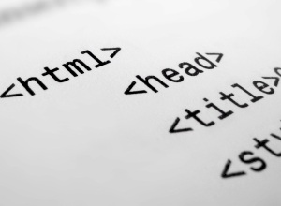

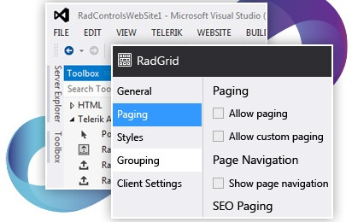

ASP.NET Web Controls and HTML Controls
ASP.NET Web Forms
Telerik Software Academy
http://academy.telerik.com

Slide 2


Table of Contents
Controls Class Hierarchy in Web Forms
HTML Server Controls
Web Server Controls
Basic Web Controls
Validation Controls
List Controls
Rich Controls
HTML Escaping

Slide 3
What is ASP.NET Server Control?
ASP.NET server controls
The simplest ASP.NET components
Wrap an HTML UI element, or more complex UI
Component-oriented programming model
Executed and rendered at the server side
Example of ASP.NET server controls:
<asp:Button> → <input type="submit">
<asp:Label> → <span>
<asp:GridView> → <table><tr><td>…

Slide 4
What is ASP.NET Server Control ?(2)
Mandatory properties for all server controls:
runat="server"
ID="…"
Programming model based on events
Each user interaction causes an event
Developer decides which events to handle
Browser-specific HTML is generated
Controls deliver appropriate HTML depending on browser type

Slide 5
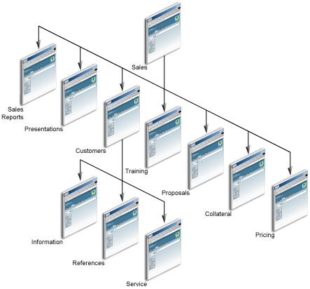


Controls – Class Hierarchy

Slide 6
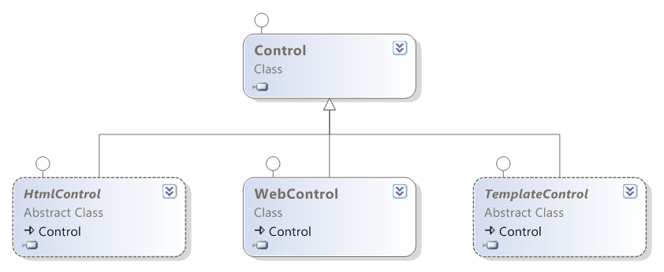
Controls – Class Hierarchy
System.Web.UI.Control
Base class for all controls
Properties – ID, Page, Context, ViewState, ClientIDMode, Controls , Parent, Visible
Methods – Render(HtmlTextWriter writer)

Slide 7
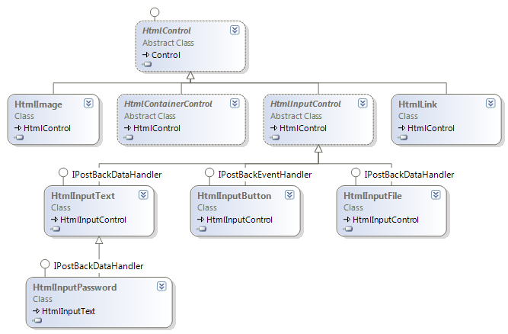
Controls – Class Hierarchy (2)
System.Web.UI.HtmlControls.HtmlControl

Slide 8
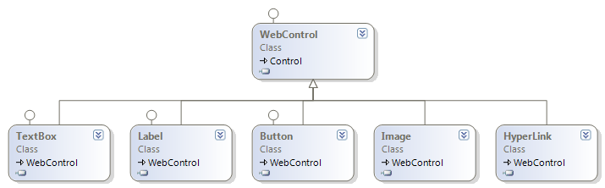
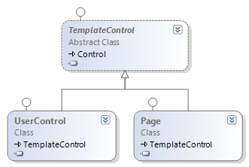
Controls – Class Hierarchy (3)
System.Web.UI.WebControls.WebControl
System.Web.UI.TemplateControl

Slide 9


HTML Server Controls

Slide 10
HTML Server Controls
HTML server controls are very simple extension of Control class
Look like traditional HTML
Defined by runat="server"
Simple HTML seems like text on the server
If an HTML element is converted to HTML server control, a server side object is associated with it
Valid only inside a Web form tag:
<form runat="server">…</form>

Slide 11
HTML Server Control – Example
<%@ Page Language="C#" %>
<script language="c#" runat="server">
void ButtonSubmit_Click(Object sender, EventArgs e) {
Response.Write("Value:<b>"+TextField.Value+"</b>");
}
</script>
<html>
<head><title>HTML Server Controls</title></head>
<body>
<form id="formMain" runat="server">
<input id="TextField" type="text" runat="server" />
<input id="ButtonSubmit" type="button"
runat="server" value="Submit"
onserverclick="ButtonSubmit_Click" />
</form>
</body>
</html>

Slide 12
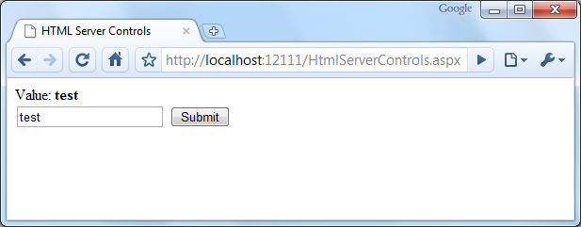
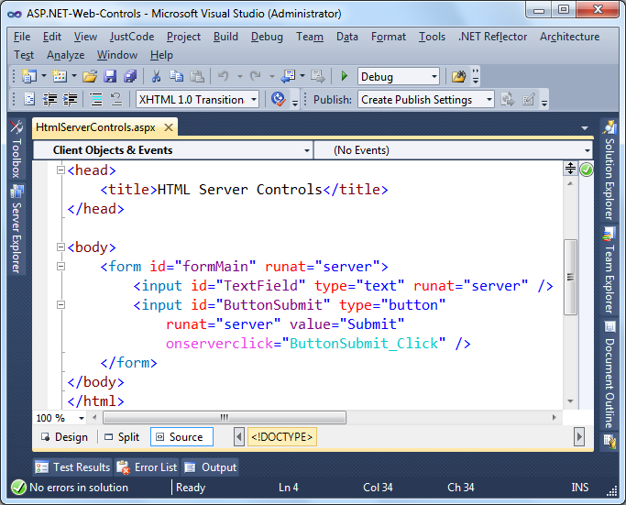
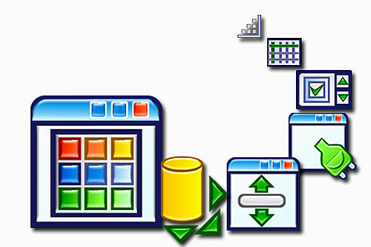
HTML Server Controls
Live Demo
Notes:
*
10/1/201407/16/96
(c) 2005 National Academy for Software Development - http://academy.devbg.org. All rights reserved. Unauthorized copying or re-distribution is strictly prohibited.*
12##

Slide 13
HTML Server Control Classes
HtmlForm – <form>…</form>
HtmlInputText – <input type="text">
HtmlButton – <input type="button" />
HtmlAnchor – <a href="…">…</a>
HtmlSelect – <input type="select">
HtmlTable, HtmlTableCell, HtmlTableRow – <table><tr><td>…</td></tr></table>
HtmlImage – <img src="…" />
...
Notes:
HtmlAnchor controls the <a> element.
HtmlButton controls the <input type="button"> element.
HtmlForm controls the <form> element.
HtmlSelect controls the <select> element.
HtmlTable controls the <table> element.
HtmlTableCell controls the <td> element.
HtmlTableRow controls the <tr> element.
HtmlTextArea controls the <textarea> element.
HtmlInputButton controls the <input type="button"> element.
HtmlInputCheckBox controls the <input type="checkbox"> element.
HtmlInputFile controls the <input type="file"> element.
HtmlInputHidden controls the <input type="hidden"> element.
HtmlInputImage controls the <input type="image"> element.
HtmlInputRadioButton controls the <input type="radio"> element.
HtmlInputText controls the <input type="text"> element.
HtmlImage controls the <img> element.

Slide 14

HTML Server Control Classes (2)
HtmlGenericControl
Used for all other HTML elements
<p>
<div>
<span>
<meta>
<body>
…

Slide 15
HtmlGenericControl – Example
<%@ Page Language="C#" %>
<script runat="server">
void Page_Load(Object sender, EventArgs e) {
this.MetaInfo.Attributes["name"] = "description";
this.MetaInfo.Attributes["content"] = "The page was
generated on: " + DateTime.Now.ToString();
}
</script>
<html>
<head>
<meta id="MetaInfo" runat="server" />
</head>
<body>
<form id="formMain" runat="server">…</form>
</body>
</html>

Slide 16
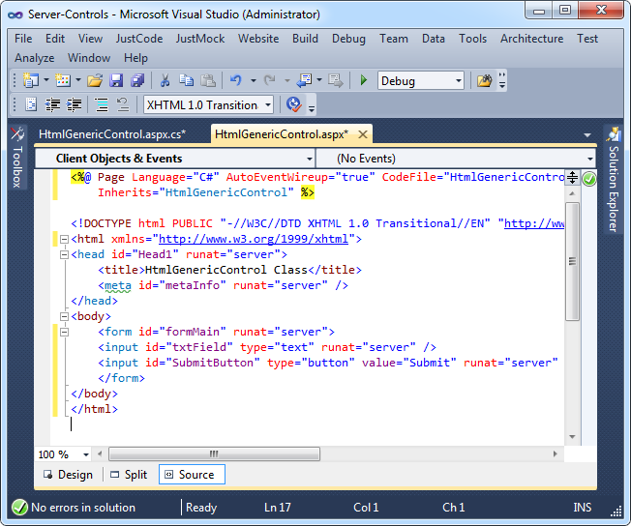
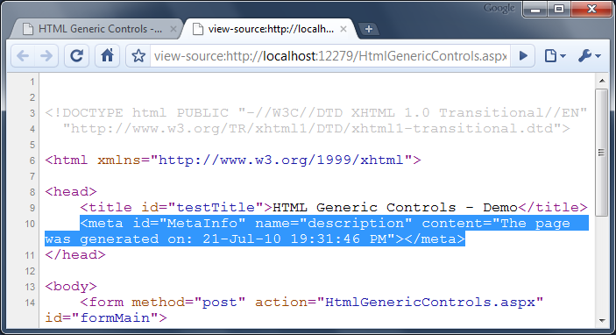

HTML Generic Controls
Live Demo

Slide 17

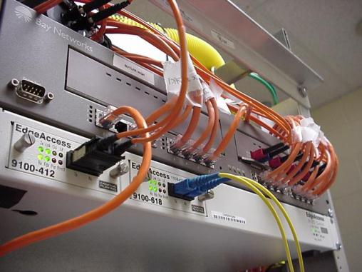

Web Server Controls

Slide 18
Web Server Controls
Web server controls are server UI controls that abstract the common HTML elements
Have own lifecycle and functionality
Built-in with .NET Framework
Located in System.Web.UI.WebControls namespace
Inherit from the WebControl class
The rendered HTML tags are quite different from the design-time markup

Slide 19



Web Server Controls – Features
Rich functionality
Type-safe programming capabilities
Automatic Web browser detection
AutoPostBack
Submit when the focus is lost
Support for themes

Slide 20
Web Server Controls – Syntax
tag_prefix determines unique namespace for the web control
Attributes are properties of the Web control
<tag_prefix:controlname attributes runat="server"/>
Mandatory attribute runat="server"
The name of the control

Slide 21
Web Server Control – Example
<form id="formMain" runat="server">
<asp:Label ID="LabelResult" runat="server"
Text="" Visible="false" />
<asp:TextBox ID="TextBoxInput" runat="server" />
<asp:Button ID="ButtonSubmit" runat="server"
Text="Submit" OnClick="ButtonSubmit_Click" />
</form>
…
protected void ButtonSubmit_Click(
object sender, EventArgs e)
{
this.LabelResult.Text =
"You entered: " + this.TextBoxInput.Text;
this.LabelResult.Visible = true;
}

Slide 22
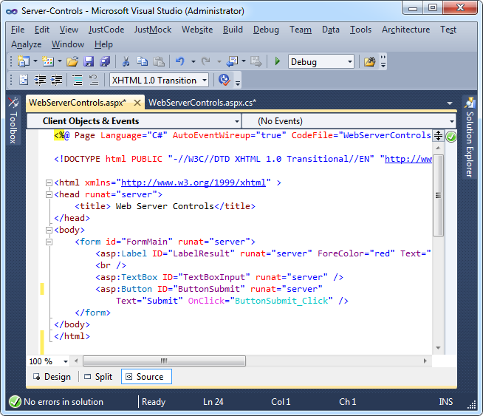
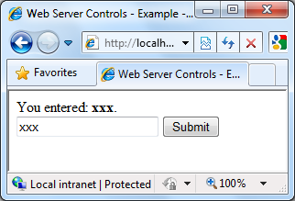
Web Server Controls
Live Demo

Slide 23
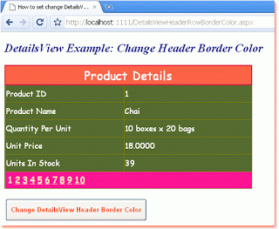
System.Web.UI. WebControls.WebControl
The WebControl class defines properties, events and methods for all Web controls
Control the appearance
BackColor
ForeColor
BorderWidth
BorderStyle
BorderColor

Slide 24
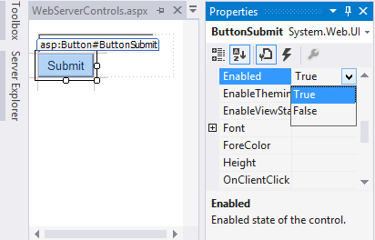
System.Web.UI. WebControls.WebControl (2)
Control the behavior
Enabled
Visible
TabIndex
ToolTip
…
Not all controls support all these properties
See the documentation for details

Slide 25
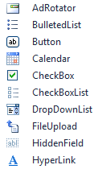
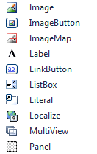
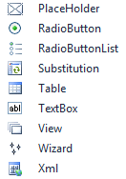
Web Server Controls
Basic Web Controls

Slide 26
Basic Web Controls ⬄ HTML
<asp:button> | <input type="submit">
<asp:checkbox> | <input type="checkbox">
<asp:hyperlink> | <a href="…"></a>
<asp:image> | <img src="…">
<asp:imagebutton> | <input type="image">
<asp:linkButton> | <a href="…"></a>
<asp:label> | <span>…</span>
<asp:listbox> | <select size="5"></select>
<asp:panel> | <div>…</div>
<asp:radiobutton> | <input type="radio">
<asp:table> | <table>…</table>
<asp:textbox> | <input type="text">

Slide 27

Basic Web Controls: TextBox
Creates single-line or multiline text-box
Lets the user to enter text
Properties
Text
TextMode – SingleLine, MultiLine, Password
MaxLength
ReadOnly
AutoPostBack
Events
TextChanged – combined with AutoPostBack

Slide 28

Basic Web Controls: Label
Display static text in a <label> input
Allows programmatically to manipulate it
Properties
Text
AssociatedControlID – on click focus goes to the specified control
Events
TextChanged – combined with AutoPostBack
CAUTION: the Text is NOT HTML encoded before it is displayed in the Label control. This make it possible to embed script within HTML tags in the text.

Slide 29
Basic Web Controls: Literal
Display static text
Allows programmatically to manipulate it
Unlike the Label control, Literal does not let you apply styles to its content
Properties
Text
Renders the Text property value directly
Use Mode="Encode" for automatic escaping
CAUTION: the Text is NOT HTML encoded before it is displayed in the Literal control. This make it possible to embed script within HTML tags in the text.

Slide 30

Basic Web Controls – Buttons
Implement IButtonControl
Button, LinkButton, RadioButton, …
Properties
Value – button's title
CommandName – pass a command
CommandArgument – pass command arguments
PostBackUrl – posts back to specified page
CausesValidation – perform validation or not
ValidationGroup – which validation group to be validated

Slide 31


Basic Web Controls – Buttons (2)
Button Events
Click
Command
CommandName and CommandArgument are passed to the C# code at the server-side

Slide 32

Basic Web Controls – Buttons (3)
<asp:Button />
Different button types
Standard button
System.Web.UI.WebControls.Button
Submits the form by default
Has a command name associated (CommandName property)
Programmatically determine which button is clicked in the Command event handlers
<asp:Button ID="ButtonOK" runat="server" Text="Click here …" />

Slide 33

Basic Web Controls – Buttons (5)
Different button types
Link button
Same functionality as Button
Renders as hyperlink
Use Hyperlink if you want to link to another page
Renders JavaScript on the client browser
<asp:LinkButton ID="ButtonHomePage" runat="server" Text="Home Page" />

Slide 34




Basic Web Controls – Buttons (6)
Different button types
ImageButton
Display an image that responds on mouse click
ImageURL – URL to displayed image
Both Click and Command events are raised
<asp:ImageButton ID="ButtonSubscribe" runat="server" ImageUrl="~/img/btn_subscribe.png" />

Slide 35
Buttons – Example
<%@ Page Language="C#" AutoEventWireup="true" CodeFile="Buttons.aspx.cs" Inherits="Buttons" %>
<!DOCTYPE html PUBLIC "-//W3C//DTD XHTML 1.0 Transitional//EN"
"http://www.w3.org/TR/xhtml1/DTD/xhtml1-transitional.dtd">
<html xmlns="http://www.w3.org/1999/xhtml">
<head runat="server">
<title>Untitled Page</title>
</head>
<body>
<form id="formMain" runat="server">
<asp:Button ID="ButtonEx"
CommandName="ButtonEx"
runat="server"
OnClick="OnBtnClick"
OnCommand="OnCommand"
Text="Normal Button" />
<br />

Slide 36
Buttons – Example (2)
<asp:LinkButton ID="LinkButtonEx"
runat="server"
OnClick="OnBtnClick"
Text="Link Button"
CommandName="LinkButtonEx"
OnCommand="OnCommand" />
<br />
<asp:ImageButton ID="ImageButtonEx"
runat="server"
CommandName="ImageButtonEx"
ImageUrl="~/images/DotNet_Logo_Small.gif"
OnCommand="OnCommand"
OnClick="OnBtnClick" />
<br />
<asp:Label ID="LabelMessage"
runat="server" Text=""></asp:Label>
</form>
</body>
</html>

Slide 37




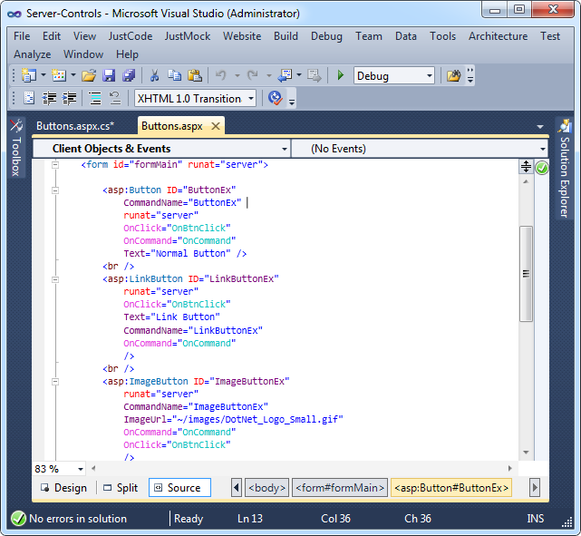
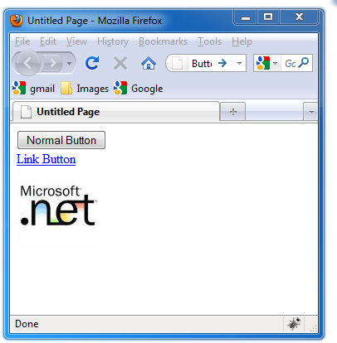
Buttons
Live Demo
Notes:
*
10/1/201407/16/96
(c) 2005 National Academy for Software Development - http://academy.devbg.org. All rights reserved. Unauthorized copying or re-distribution is strictly prohibited.*
37##

Slide 38
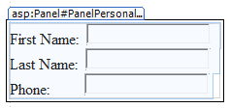
Basic Web Controls – Panel
The Panel control
Container for other controls
Rendered as <div>
Useful for:
Grouping controls
Easier for layout positioning and hiding/showing
Generating and inserting controls at runtime

Slide 39
Basic Web Controls – Panel (2)
Properties
ScrollBars – modify visibility and position of scroll bars
Wrap – value indicating whether the content wraps within the panel
GroupingText – caption for the group of controls that is contained in panel control
DefaultButton – button to be pressed by default (Enter)

Slide 40
Dynamically Generated Controls
You may generate ASP.NET controls in the controls tree dynamically
Add controls in the page / control tree in the Init / Load events
If added later, the events from the dynamic controls will not be able to be handled
protected void Page_Load(object sender, EventArgs e)
{
TextBox textBox = new TextBox();
textBox.Text = "Dynamic TextBox";
this.Controls.Add(textBox);
}

Slide 41
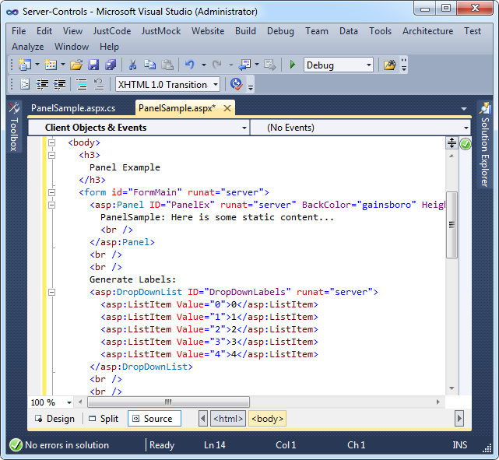
Panels and Dynamic Controls
Live Demo
Notes:
*
10/1/201407/16/96
(c) 2005 National Academy for Software Development - http://academy.devbg.org. All rights reserved. Unauthorized copying or re-distribution is strictly prohibited.*
41##

Slide 42

Basic Web Controls – MultiView
MultiView displays one of few panels (views) that reside inside it
ActiveViewIndex – indicated which of the views to be displayed
SetActiveView – changes the active view
Views – holds the views

Slide 43

Basic Web Controls – CheckBox
Select between checked / unchecked
Properties
Checked
Text – control caption
AutoPostBack
Automatically posts back the page when control state is changed
<asp:CheckBox ID="CheckBoxAgree" runat="server" />

Slide 44
Basic Web Controls – CheckBox (2)
CausesValidation – whether validation is performed
ValidationGroup – which validation group to be validated
Events
CheckChanged

Slide 45


Basic Web Controls – RadioButton
Creates a radio button on the Web Forms page
Properties
Text
GroupName – allow a mutually exclusive selection from the group
AutoPostBack
Automatically posts back the page when control state is changed
See also RadioButtonList

Slide 46

Basic Web Controls – PlaceHolder
The PlaceHolder control
Reserves a space in the page control hierarchy
Used to add controls to the page at runtime
Does not produce any visible output
The Controls properties
Use it to add, insert or remove controls from PlaceHolder Control

Slide 47


Validation Controls
Performing Control Validation

Slide 48
Validation Controls
The ASP.NET Web forms validation controls
Validate the values that are entered into other controls of the page (e.g. in a TextBox)
Most important validation controls:
RequiredFieldValidator
RangeValidator
CompareValidator
RegularExpressionValidator
ValidationSummary

Slide 49

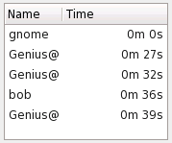





List Controls
Displaying Lists of Items

Slide 50
List Controls
List Web controls
Display list of items, e.g. table of rows
Support binding to a collection
Display rows of data in templated format
Expose data binding properties: DataSourceID, DataSource, DataMember
Bind to collection that support IEnumerable, ICollection or IListSource
Can bind to databases through Entity Framework

Slide 51


List Controls (2)
ListBox
CheckBoxList
RadioButtonList
BulletedList
Repeater
DataList
GridView
DropDownList
ListView

Slide 52
ListBox
The ListBox control
Holds a list of items
Each item has text and value
SelectionMode: Single or Multiple
Items can be data-bound or provided statically
<asp:ListBox ID="ListBoxTowns" runat="server">
<asp:ListItem Value="1">Sofia</asp:ListItem>
<asp:ListItem Value="2">Plovdiv</asp:ListItem>
<asp:ListItem Value="3">Varna</asp:ListItem>
</asp:ListBox>

Slide 53

DropDownList
The DropDownList control (combo-box)
Allows choosing among a list of items, just like ListBox
Each item has text and value
Items can be data-bound or provided statically
<asp:DropDownList ID="DropDownListTransport" runat="server" AutoPostBack="True">
<asp:ListItem Value="2">Bus</asp:ListItem>
<asp:ListItem Value="1">Train</asp:ListItem>
</asp:DropDownList>

Slide 54

BulletedList
BulletedList displays data in the form of a list of bullets
DisplayMode
Text, HyperLink, LinkButton
Ordered or unordered
BulletStyle
Can be Circle, Disk, LowerRoman, …
BulletImageUrl
FirstBulletNumber

Slide 55
CheckBoxList
CheckBoxList displays items as check boxes
RepeatColumns
The number of columns
RepeatDirection
Vertical, Horizontal
RepeatLayout: Table, Flow
<asp:CheckBoxList ID="Extras" runat="server">
<asp:ListItem Text="Audio System" Value="1" />
<asp:ListItem Text="Parktronic" Value="2"
Selected="True" />
</asp:CheckBoxList>

Slide 56
RadioButtonList
RadioButtonList displays data as a list of RadioButton controls
RepeatColumns – the number of columns displayed
RepeatDirection
Vertical, Horizontal
RepeatLayout
Table, Flow
Use the Items property to access its elements

Slide 57



List Controls
Live Demo

Slide 58


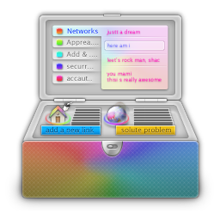
Web Server Controls
Rich Controls

Slide 59
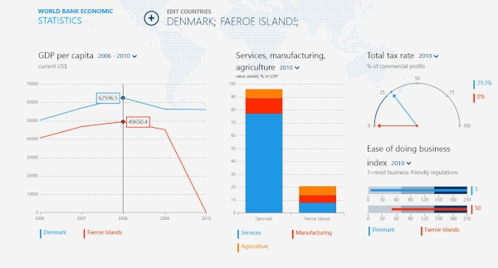
Rich Controls
Task-specific controls
Built with multiple HTML elements
Encapsulate more complex functionality
Rich functionality
Examples:
Calendar
Menu
AdRotator
CreateUserWizzard

Slide 60


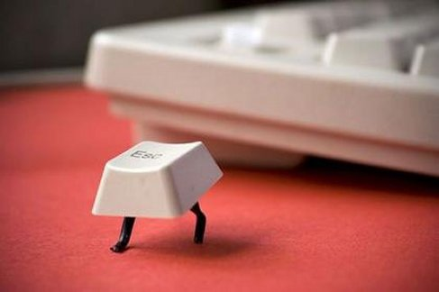

HTML Escaping

Slide 61

What is HTML Escaping?
HTML escaping is the act of replacing special characters with their HTML entities
Escaped characters are interpreted as character data instead of mark up
Typical characters to escape
<, > – start / end of HTML tag
& – start of character entity reference
', " – text in single / double quotes
…

Slide 62
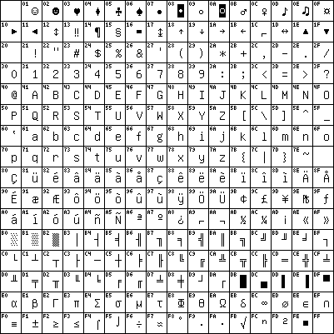
HTML Character Escaping
Each character could be presented as HTML entity escaping sequence
Numeric character references:
'λ' is &#955;, &#x03BB; or &#X03bb;
Named HTML entities:
'λ' is &lambda;
'<' is &lt;
'>' is &gt;
'&' is &amp;
" (double quote) is &quot;

Slide 63
How to Encode HTML Entities?
HttpServerUtility.HtmlEncode
HTML encodes a string and returns the encoded (html-safe) string
Page.Server is instance of HttpServerUtility
Example:
Output:
Web browser renders the following:
<%response.write(Server.HtmlEncode("The image tag: <img>"))%>
The image tag: &lt;img&gt;
The image tag: <img>

Slide 64
How to Encode HTML Entities? (2)
You could also use the following syntax to escape text with HTML tags:
The best way to safely display text in ASP.NET page is to use Literal with Mode="Encode":
Never do double-escaping!
Never store HTML escaped text in the DB!
<%: "I want to display an <img> tag here." %>
<asp:Literal Mode="Encode" Text="You could freely
use <img> and <p> tags here." />

Slide 65
How to Encode HTML Entities? (3)
TextBox text does not need to be escaped
Label text needs to be escaped
Difference between %, %: and %=
<asp:TextBox Mode="Encode" Text="You could freely
use <img> and <p> tags here." />
<asp:Label Mode="Encode“
Text="<script>alert('bug!')</script>" />
<% “<b>This will not be escaped!</b>" %>
<%: "I want to display an <img> tag here." %>
<%= "<script>alert('Not good!')</script>" %

Slide 66
XSS Attack
Cross-site scripting (XSS) is a common security vulnerability in Web applications
Web application is let to display a JavaScript code that is executed at the client's browser
Crackers could take control over sessions, cookies, passwords, and other private data
How to prevent XSS?
Validate the user input (built-in in ASP.NET)
Perform HTML escaping when displaying text data in a Web control

Slide 67
Automatic Request Validation
ASP.NET applies automatic request validation
Controlled by the ValidateRequest attribute of Page directive
Checks all input data against a hard-coded list of potentially dangerous values
The default is true
Using it could harm the normal work on most applications
E.g. a user posts JavaScript code in a forum
Escaping is a better way to handle the problem!

Slide 68
Bad Characters Protection
The ASP.NET built-in protection against XSS
By default stops all HTTP requests that send un-escaped HTML code
An error message is shown when a form sends HTML to the server
Disable the HTTP request validation for all pages in Web.config (in <system.web>):
500 Internal Server Error: A potentially dangerous Request.Form value was detected from the client (…)
<httpRuntime requestValidationMode="2.0" />
<pages validateRequest="false" />

Slide 69
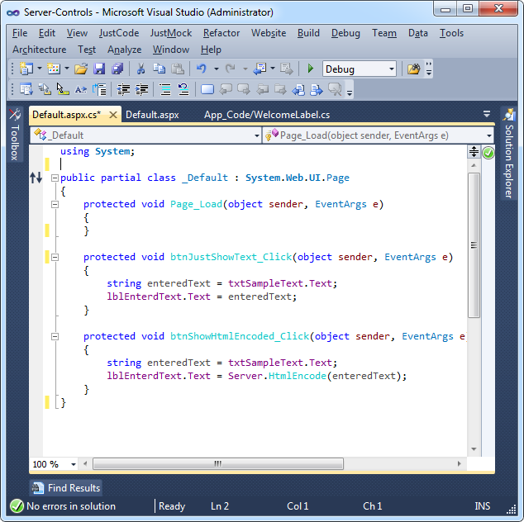
HTML Escaping
Live Demo
Notes:
*
10/1/201407/16/96
(c) 2005 National Academy for Software Development - http://academy.devbg.org. All rights reserved. Unauthorized copying or re-distribution is strictly prohibited.*
69##

Slide 70
ASP.NET Web Controls and HTML Controls
http://academy.telerik.com

Slide 71
Homework
Using the HTML server controls create a Web application for generating random numbers. It should have two input fields defining a range (e.g. [10..20]) and a button to generate a random number in the specified range.
Re-implement the same using Web server controls.
Define a Web form with text box and button. On button click show the entered in the first textbox text in other textbox control and label control. Enter some potentially dangerous text. Fix issues related to HTML escaping – the application should accept HTML tags and display them correctly.

Slide 72
Homework (2)
Make a simple Web form for registration of students and courses. The form should accept first name, last name, faculty number, university (drop-down list), specialty (drop-down list) and a list of courses (multi-select list) and display them on submit. Use the appropriate Web server controls. After submission you should display summary of the entered information as formatted HTML. Use dynamically generated tags (<h1>, <p>, …).
* Implement the "Tic-tac-toe" game using Web server controls. The user should play against the computer which follows some fixed strategy.

Slide 73
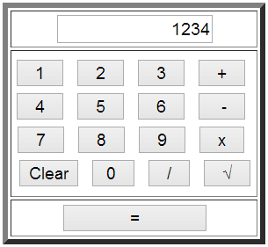
Homework (3)
Make a simple Web Calculator. The calculator should support the operations like addition, subtraction, multiplication, division and square root. Validation is essential!

Slide 74



Free Trainings @ Telerik Academy
"Web Design with HTML 5, CSS 3 and JavaScript" course @ Telerik Academy
html5course.telerik.com
Telerik Software Academy
academy.telerik.com
Telerik Academy @ Facebook
facebook.com/TelerikAcademy
Telerik Software Academy Forums
forums.academy.telerik.com

